Slide 1
Interrupts

Slide 2
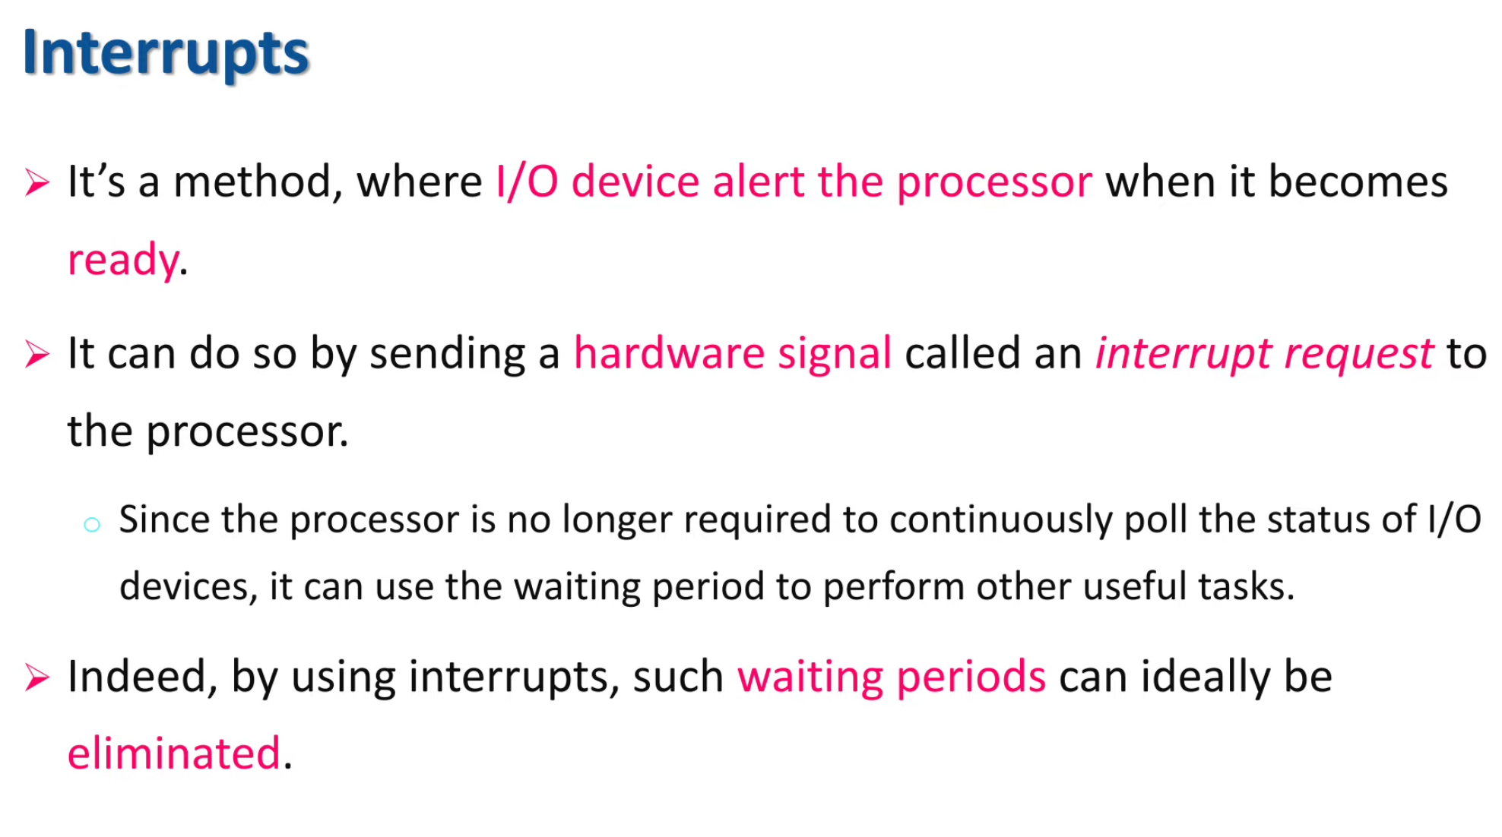

Slide 3
Interrupt Driven I/O
The problem with programmed I/O is that the processor has to wait a long time for the I/O module of concern to be ready for either reception or transmission of data.
The processor, while waiting, must repeatedly interrogate the status of the I/O module.
As a result, the level of the performance of the entire system is severely degraded.
An alternative is for the processor to issue an I/O command to a module and then go on to do some other useful work.
The I/O module will then interrupt the processor to request service when it is ready to exchange data with the processor.
The processor then executes the data transfer, as before, and then resumes its former processing

Slide 4
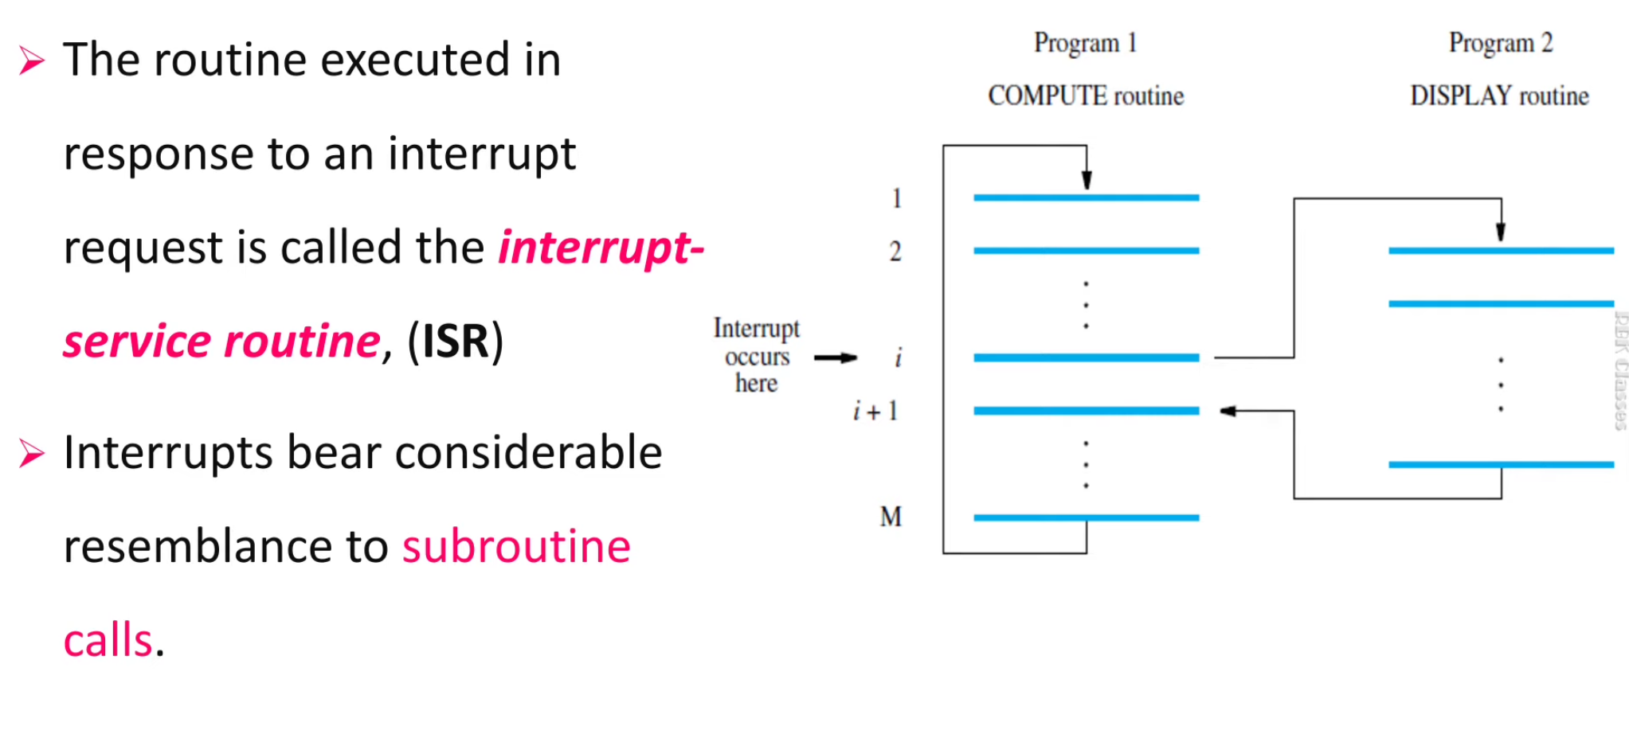
Interrupt Service Routine

Slide 5
Interrupts (contd..)
Program 1
Interrupt Service routine
1
2
Interrupt
occurs
i
here
i
+
1
M
Processor is executing the instruction located at address i when an interrupt occurs.
Routine executed in response to an interrupt request is called the interrupt-service routine.
When an interrupt occurs, control must be transferred to the interrupt service routine.
But before transferring control, the current contents of the PC (i+1), must be saved in a known
location.
This will enable the return-from-interrupt instruction to resume execution at i+1.
Return address, or the contents of the PC are usually stored on the processor stack.

Slide 6
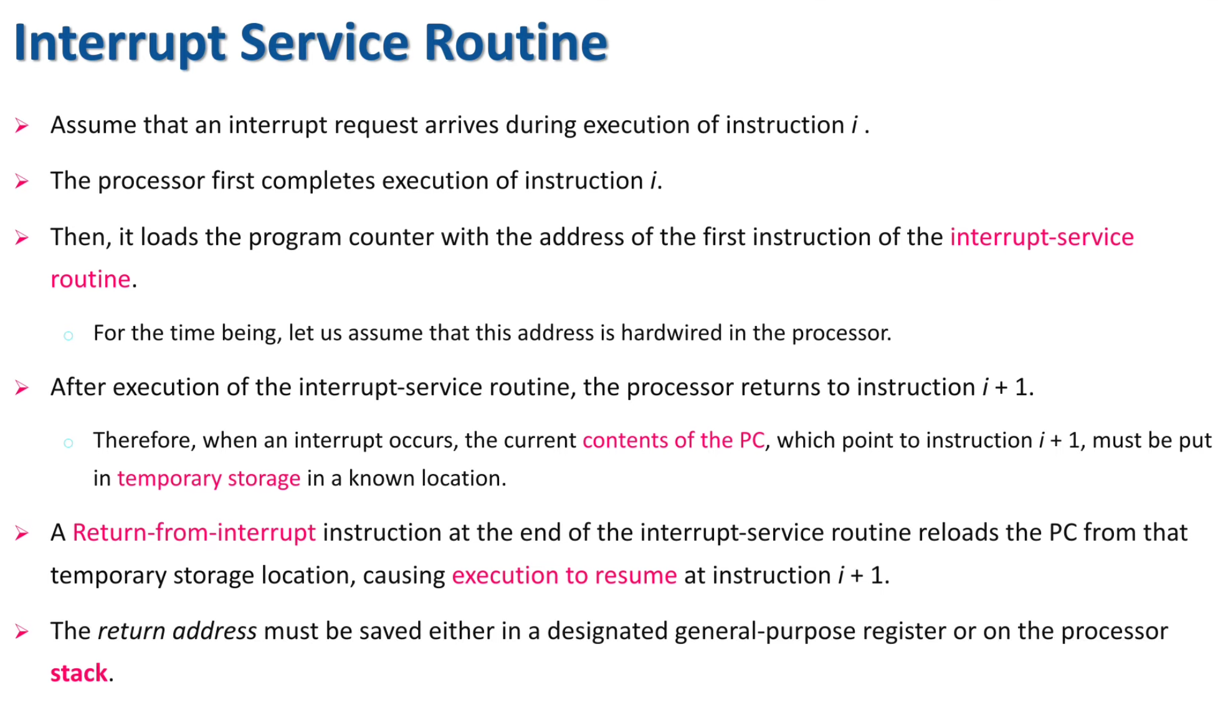

Slide 7
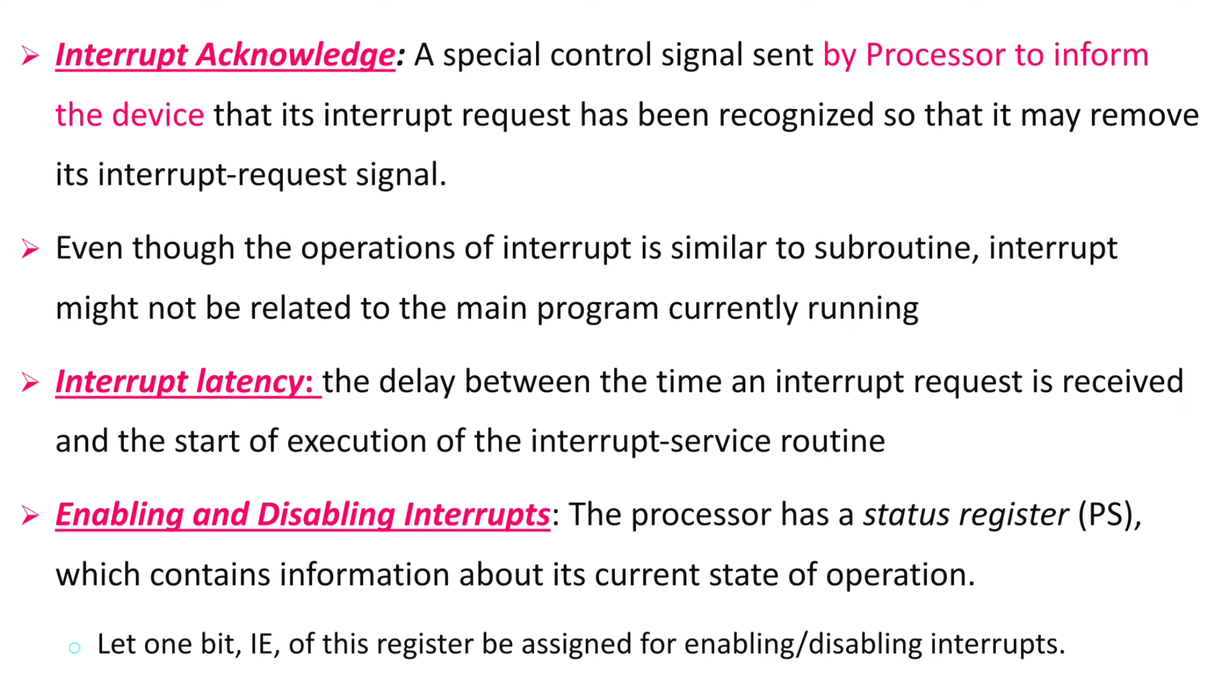

Slide 8
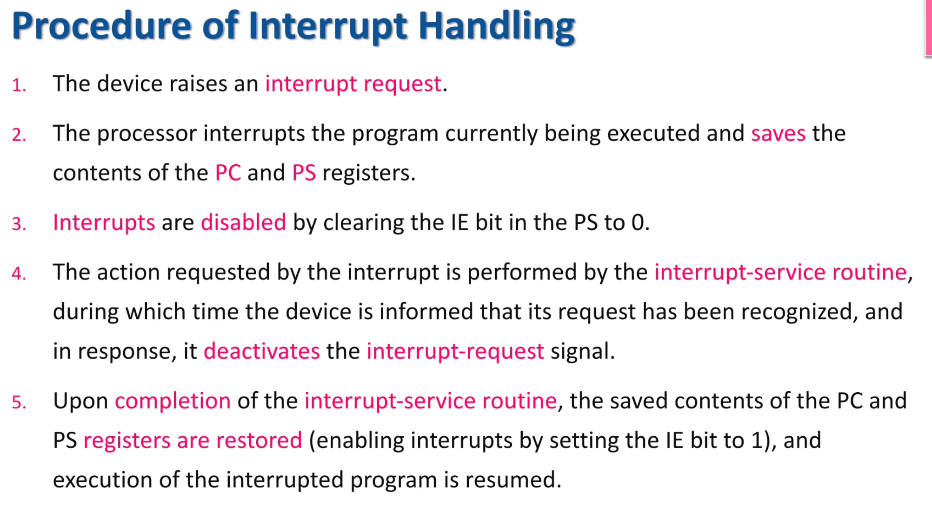

Slide 9
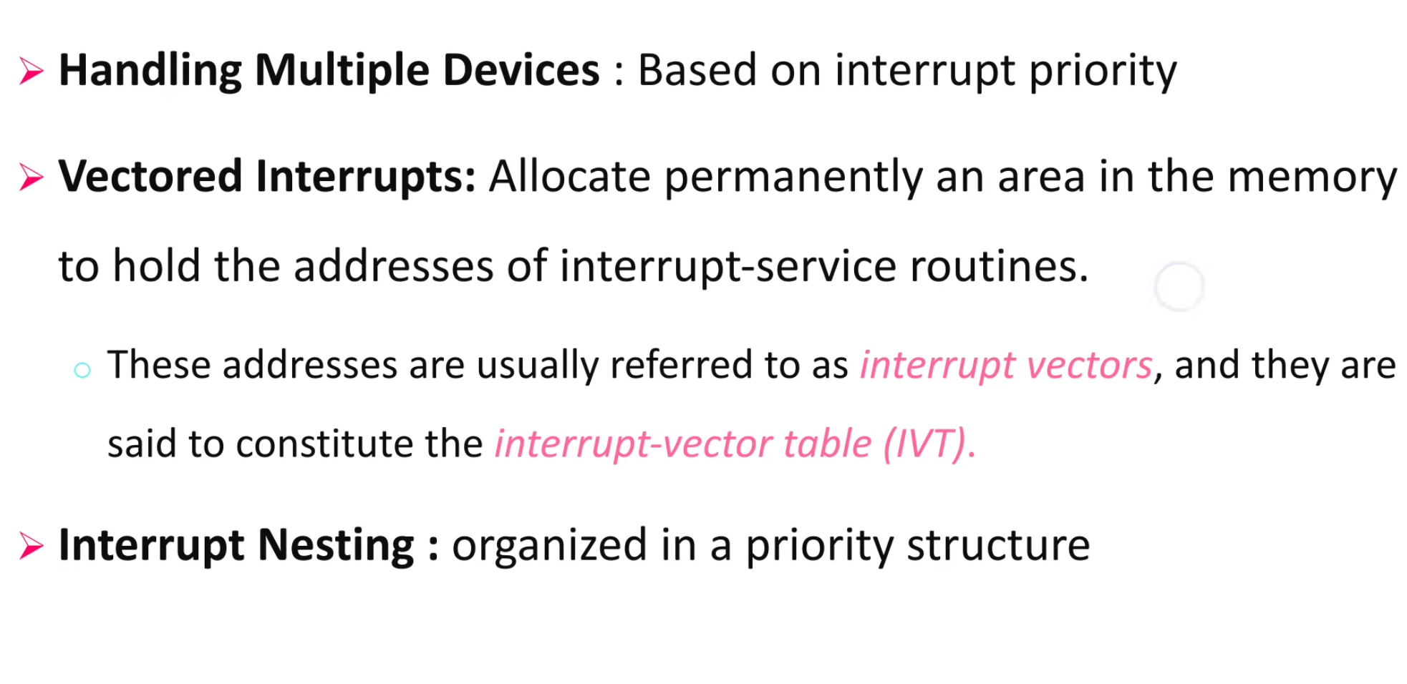

Slide 10
Interrupts (contd..)
Which interrupt request does the processor accept if it receives interrupt requests from two or more devices simultaneously?.
If the I/O devices are organized in a priority structure, the processor accepts the interrupt request from a device with higher priority.
  Each device has its own interrupt request and interrupt acknowledge line.
  A different priority level is assigned to the interrupt request line of each device.
However, if the devices share an interrupt request line, then how does the processor decide which interrupt request to accept?

Slide 11
Interrupts (contd..)
I
N
T
R
1
I
N
T
R
p
Processor
Device 1
Device 2
Device
p
INTA1
INTA
p
Priority arbitration
Each device has a separate interrupt-request and interrupt-acknowledge line.
Each interrupt-request line is assigned a different priority level.
Interrupt requests received over these lines are sent to a priority arbitration circuit
in the processor.
If the interrupt request has a higher priority level than the priority of the processor,
then the request is accepted.

Slide 12
Design Issues
Two design issues arise in implementing interrupt I/O.
First, because there will be multiple I/O modules, how does the processor determine which device issued the interrupt?
And second, if multiple interrupts have occurred, how does the processor decide which one to process?

Slide 13
Device Identification
Four general categories of techniques are in common use
Multiple interrupt lines
Software poll
Daisy chain (hardware poll, vectored)
Bus arbitration (vectored)
Multiple interrupt lines
The most straightforward approach to the problem is to provide multiple interrupt lines between the processor and the I/O modules.
However, it is impractical to dedicate more than a few bus lines or processor pins to interrupt lines.

Slide 14
Interrupts (contd..)
Polling scheme:
If the processor uses a polling mechanism to poll the status registers of I/O devices
to determine which device is requesting an interrupt.
In this case the priority is determined by the order in which the devices are polled.
The first device with status bit set to 1 is the device whose interrupt request is
accepted.
Daisy chain scheme:
I
N
T
R
Processor
INTA
Device 1
Device 2
Device
n
Devices are connected to form a daisy chain.
Devices share the interrupt-request line, and interrupt-acknowledge line is connected
to form a daisy chain.
When devices raise an interrupt request, the interrupt-request line is activated.
The processor in response activates interrupt-acknowledge.
Received by device 1, if device 1 does not need service, it passes the signal to device 2.
Device that is electrically closest to the processor has the highest priority.

Slide 15
Interrupts (contd..)
When I/O devices were organized into a priority structure, each device had its own
interrupt-request and interrupt-acknowledge line.
When I/O devices were organized in a daisy chain fashion, the devices shared an
interrupt-request line, and the interrupt-acknowledge propagated through the devices.
A combination of priority structure and daisy chain scheme can also used.
I
N
T
R
1
INTA1
Device
Device
Processor
I
N
T
R
p
INTA
p
Device
Device
Priority arbitration
circuit
Devices are organized into groups.
Each group is assigned a different priority level.
All the devices within a single group share an interrupt-request line, and are
connected to form a daisy chain.

Slide 16
Bus arbitration.
With bus arbitration, an I/O module must first gain control of the bus before it can raise the interrupt request line.
Thus, only one module can raise the line at a time.
When the processor detects the interrupt, it responds on the interrupt acknowledge line.
The requesting module then places its vector on the data lines.
These techniques serve to identify the requesting I/O module.
They also provide a way of assigning priorities when more than one device is requesting interrupt service.

Slide 17
Interrupts (contd..)
Only those devices that are being used in a program should be allowed to generate interrupt requests.
To control which devices are allowed to generate interrupt requests, the interface circuit of each I/O device has an interrupt-enable bit.
  If the interrupt-enable bit in the device interface is set to 1, then the device is allowed to generate an interrupt-request.
Interrupt-enable bit in the device’s interface circuit determines whether the device is allowed to generate an interrupt request.
Interrupt-enable bit in the processor status register or the priority structure of the interrupts determines whether a given interrupt will be accepted.

Slide 18
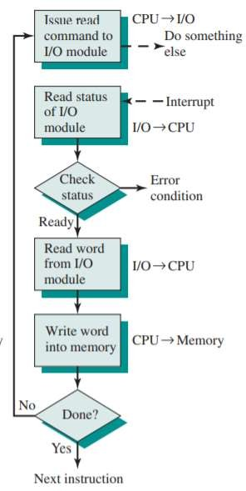
Interrupt I/O is more efficient than programmed I/O because it eliminates needless waiting.
However, interrupt I/O still consumes a lot of processor time, because every word of data that goes from memory to I/O module or from I/O module to memory must pass through the processor.

Slide 19
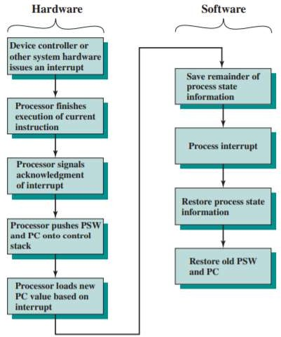
Interrupt Processing

